Slide 1
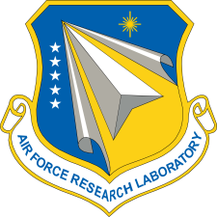
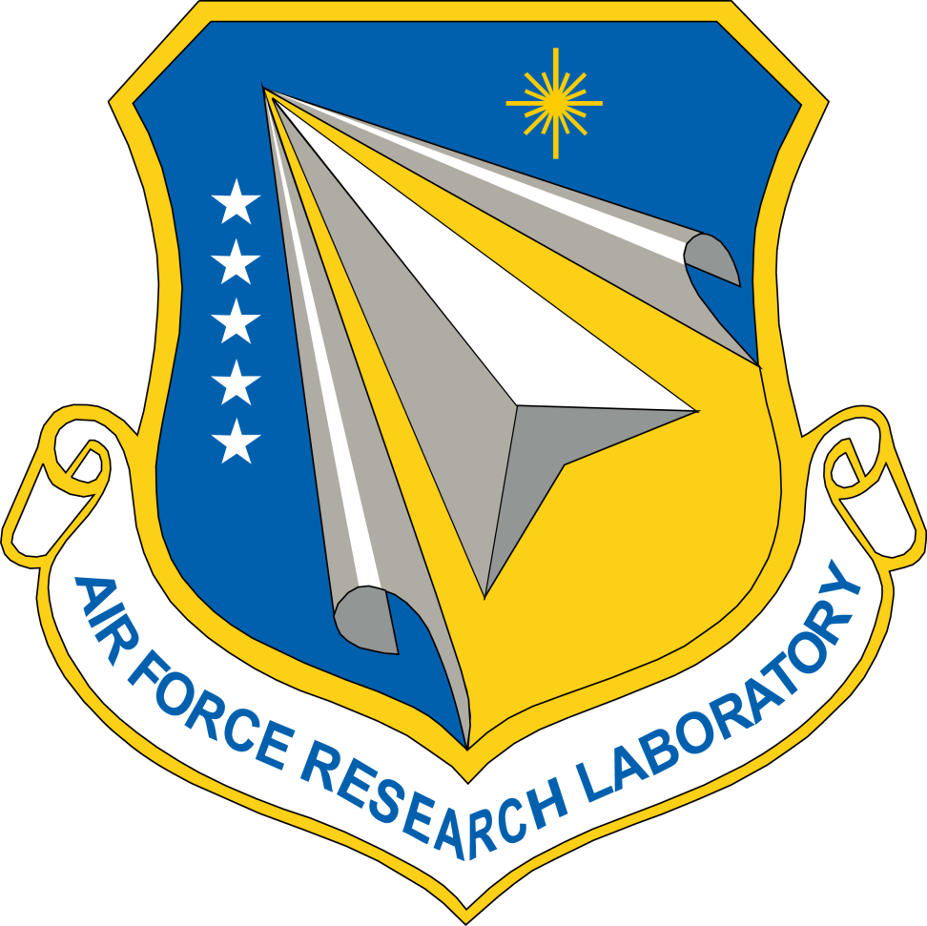
DMC 2017
Integrity  Service  Excellence

Slide 2
2017 Sessions
Tuesday Afternoon: MRL Training
Part One: Tom Lastoskie
Part Two: Dave Karr
Wednesday Afternoon: MRL Activities/Best Practices
OSD Perspective: Rob Gold
MRL Working Group Activities: Scott Pearl
MRL/AS6500 Integration: Dave Karr
MRL Assessment Tool: Elizabeth Loiacono
Industry Case Studies
Jeffrey Shubrooks, Raytheon
Lane Ballard, Boeing

Slide 3
Top 50 Attended Afternoon Sessions
#1: Composites, 70 attendees
#10: Tom Lastoskie’s MRL Training, 45
#17: MRL Working Group Activities, 40.7
#22: Manufacturing Roundtable, 34.7
#24: Dave Karr’s MRL Training, 34.3
#27: MRL Best Practices, 33

Slide 4
Takeaways
Good audience, appeared to be engaged and asking good questions
We were not just talking to an MRL Working Group audience
The Boeing presentation would be good for a morning industry slot at DMC 2018—spoke with Navy hosts about that
Any topics come up that would be worthwhile to explore for this year’s sessions?

